Slide 1

Paramagnetic NMR and Computational Analysis of New Triazacyclohexane Complexes of Cr(III)

Slide 2
Background
1-alkenes have many uses in industry including the synthesis of surfactants and lubricants
Shorter chains are extensively used as water-soluble surfactants, such as soaps
For the production of shorter chains, selective oligomerisation is required, to avoid separation processes

Slide 3
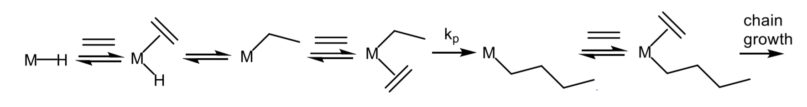
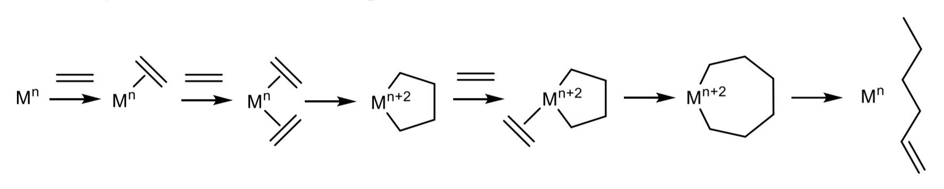
Non-selective (Cossee):
Selective (Manyik):

Slide 4
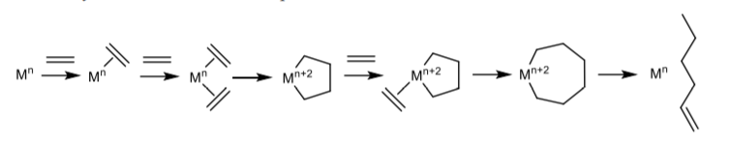
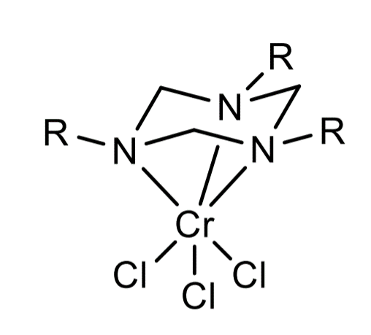
Catalyst for selective oligomerisation
1,3,5- triazacyclohexane ligands on chromium
“Cap” can bring about the right amount of steric strain so that ring sizes up to 5 are tolerated, but ring size of 7 is thermodynamically unstable
Result: high purity of trimers produced
Issue: catalyst was found to have short life

Slide 5
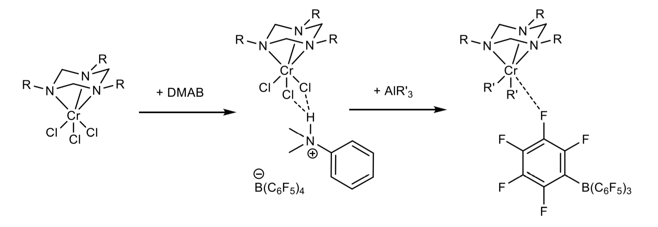
AIMS OF project
Analyse activation pathway of the catalyst using a combination of paramagnetic NMR and DFT to gain a better understanding of the process and propose ideas for optimisation
Current idea of activation pathway from previous work:

Slide 6
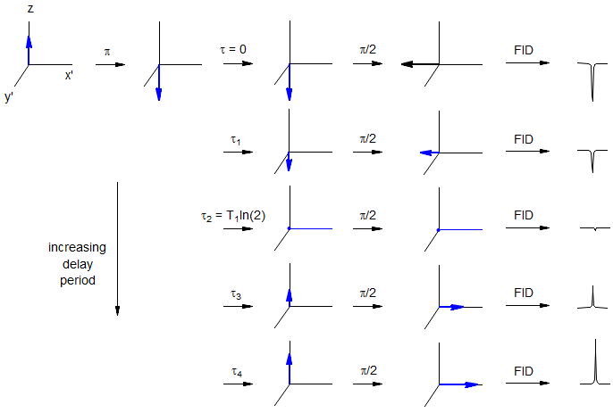
Methods: Paramagnetic NMR

Slide 7
Methods: Paramagnetic nmr
Paramagnetic NMR takes advantage of the ability of unpaired electrons in a complex to reduce nuclear relaxation times
T₁ = τ₀/ln(2)
T₁ time describes the spin-lattice relaxation time
T₁ time can be used to find R/τ_{c} (quantity relating to distance and shielding from paramagnetic centre)

Slide 8
Methods: Computational chemistry
Possible conformation for each species (different R groups) were considered
Initial coordinates were gained from building the complex in Chem3D, setting the dihedral angle to the required value for each initial conformation and running molecular mechanics (MM2) calculations

Slide 9
Methods: Computational chemistry
The output of coordinates were then used as initial coordinates for DFT calculations performed by ORCA version 4.2.1 (BP86 functional) to further optimise the structure and to calculate the anisotropic spin-dipolar contributions [A(SD)]
From the A(SD) values, R values can be found (again, relating to the distance and shielding from the paramagnetic centre)

Slide 10
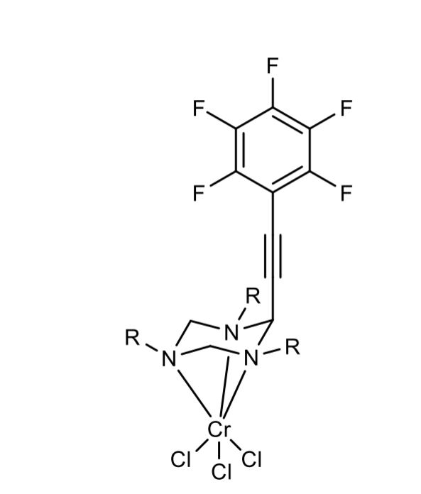
Example Complex
CCC₆F₅ group used to create more ¹⁹F nuclei for paramagnetic NMR (¹⁹F nuclei used as the signal from these nuclei rarely overlap and are intense)
R groups were planned to also contain ¹⁹F nuclei, however, it was found that in case the R groups contain these the CCC₆F₅ group gets cleaved
Chosen R group was therefore Me

Slide 11
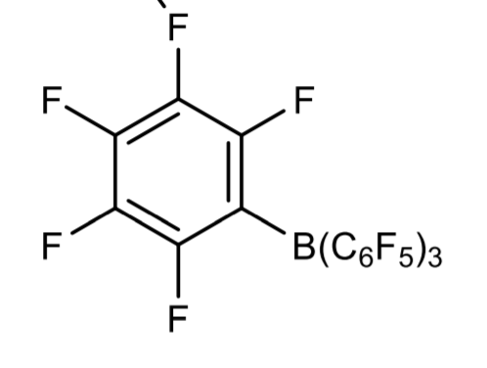
RESULTS
-

Slide 12
Results 2
Very little change in data over time
The good correlation of the experimental and computational data is in agreement with the suggested first step of activation,
DMAB interacts attractively with the complex (no change over time), but no interaction through B(C₆F₅)₄ group (as only 3 ¹⁹F environments observed on DMAB)

Slide 13
Results 3
The next step of activation involves the addition of AlR₃
It was found that the R/τ_{c} value for the borate in DMAB decreased after addition, which is in disagreement with the original proposition that one of the fluorines on the B(C₆F₅)₄ group form interactions with the Cr centre (further, there was still only 3 observable ¹⁹F environments on DMAB)
These observations were also accompanied by a decrease in the magnetic moment of the species shown by the Evans method calculations
This could indicate a decrease in oxidation state (unlikely, as in this case catalysis would not be possible) or dimerisation

Slide 14
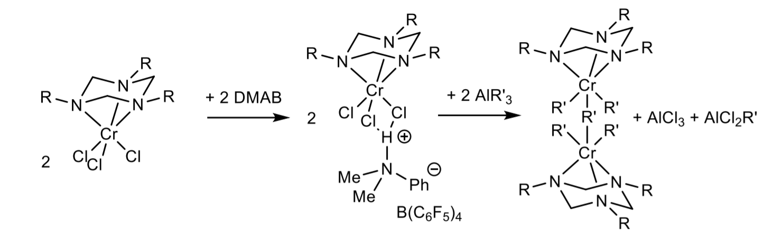
Conclusion
Based on all these results the new proposed mechanism involves the activated catalyst being a dimer
Further work involves the collection of further data to understand why the initial (borate ion linkage) or final (dimer) theory for activation of catalyst is preferred and investigation into which one produces the more stable catalyst

